Slide 1
Warm-Ups
Check your bags!!!!
Sit your normal seat.
You will need your notebook today, but we will not be using it right away.
You may talk quietly while you wait for further instructions.

Slide 2
Vocab: Picture Associations

Slide 3
Directions:
Pick the vocabulary word that is most associated with the picture.

Slide 4

nominate, freedman, secede, total war, Reconstruction

Slide 5
A = nominate
To choose.

Slide 6
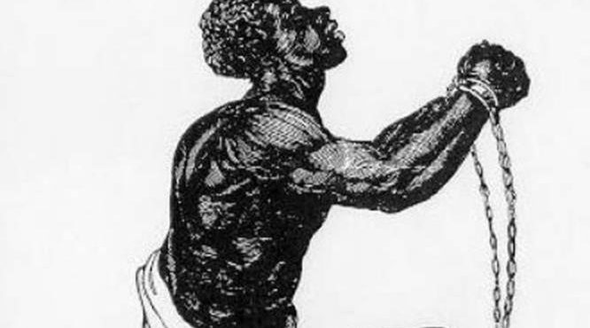
migrant, nominate, abolition, principle, suffrage

Slide 7
A = abolition
The effort to do away with slavery.

Slide 8
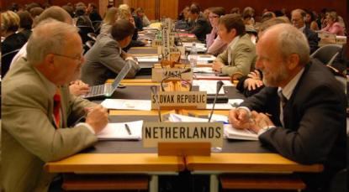
Reconstruction, tariff, secede, federal, diplomacy

Slide 9
A = diplomacy
  The art of international negotiations.

Slide 10
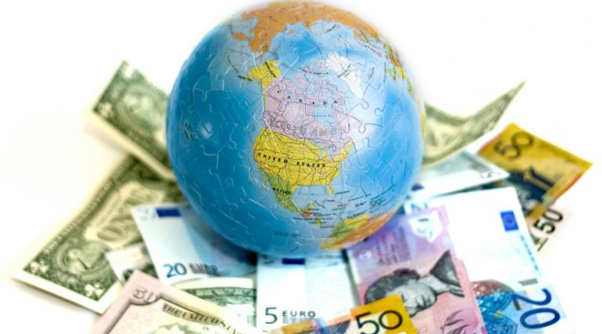
economy, principle, freedman, segregation, abolition

Slide 11
A = economy
The money and jobs of a country.

Slide 12
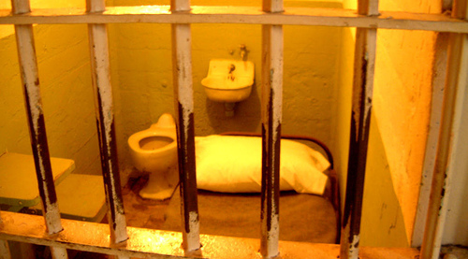
nominate, total war, principle, economy, Habeas Corpus

Slide 13
A = Habeas Corpus
The constitutional right that says you can’t be put in jail without reason, evidence, and a trial.

Slide 14
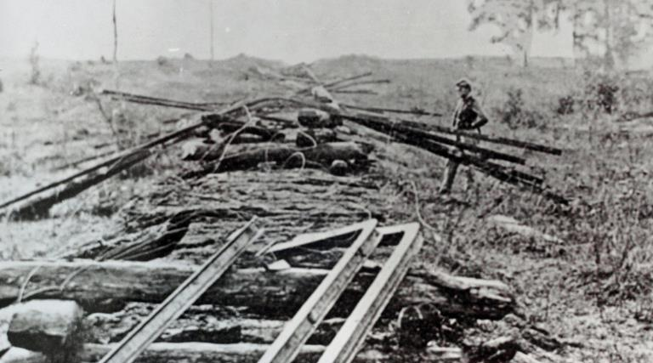
principle, freedman, economy, migrant, total war

Slide 15
A = Total War
A complete destruction of everything useful to the enemy.

Slide 16
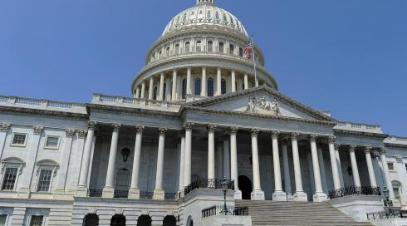
abolition, migrant, tariff, federal, persecuted

Slide 17
A = federal
National.

Slide 18
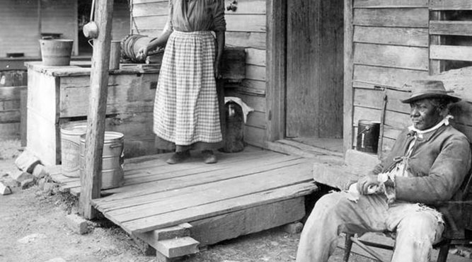
nominate, secede, freedman, fugitive, inauguration

Slide 19
A = freedman
Former slave.

Slide 20
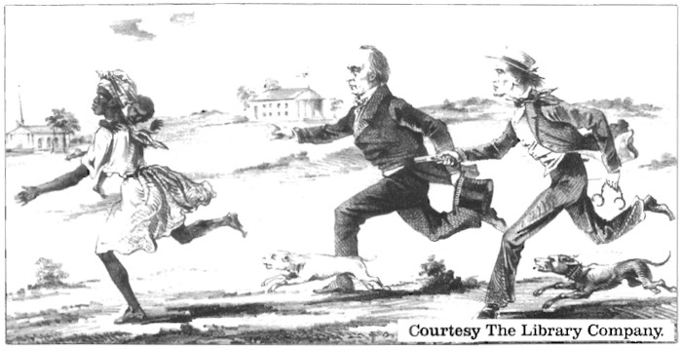
geographical barrier, migrant, fugitive, federal, tariff

Slide 21
A = fugitive
An escaped slave.

Slide 22
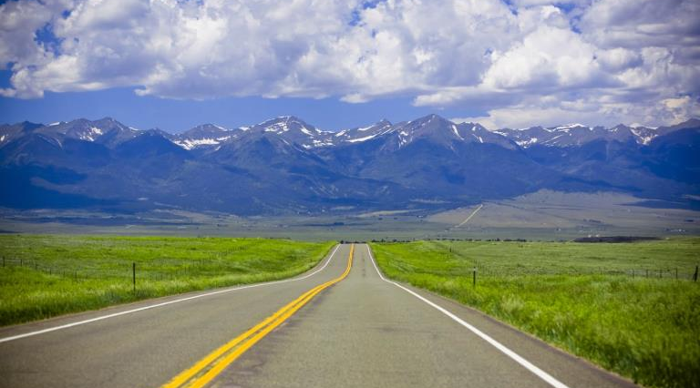
geographical barrier, secede, segregation, tariff, economy

Slide 23
A = geographical barrier
Something in nature that blocks your way.

Slide 24
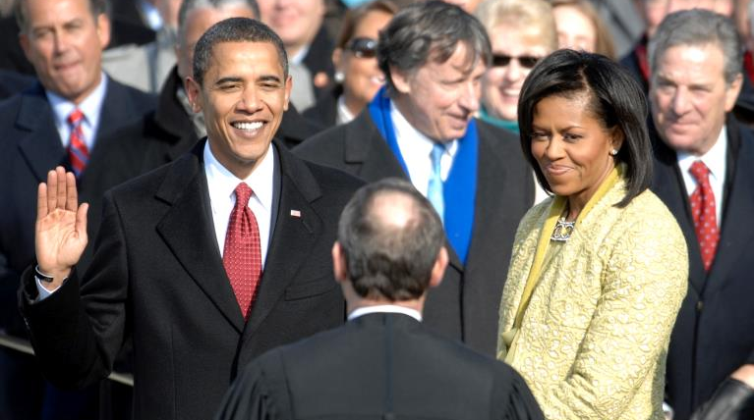
fugitive, diplomacy, abolition, inauguration, suffrage

Slide 25
A = inauguration
A ceremony that places somebody in office.

Slide 26
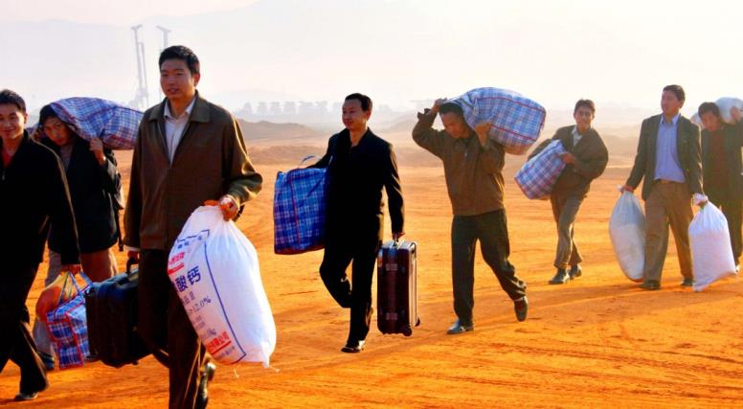
suffrage, geographical barrier, federal, diplomacy, migrant

Slide 27
A = migrant
A person that moves from place to place.

Slide 28
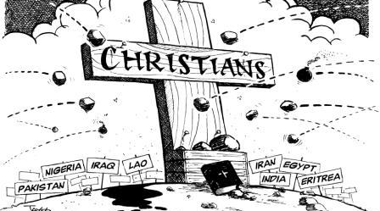
principle, persecuted, tariff, nominate, federal

Slide 29
A = persecuted
To be hurt or punished for your religion.

Slide 30
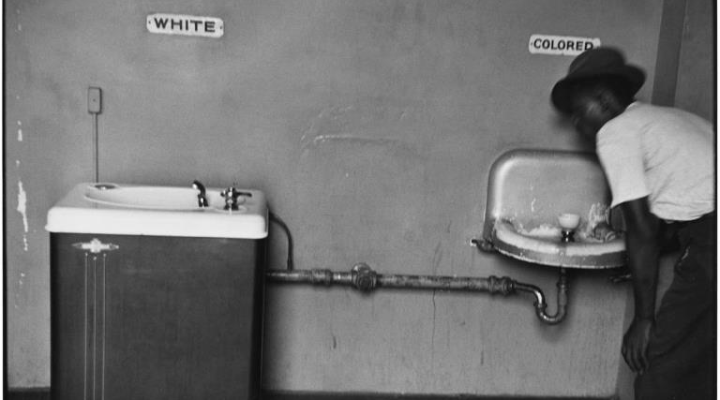
inauguration, freedman, fugitive, secede, segregation

Slide 31
A = segregation
A separation of the races.

Slide 32
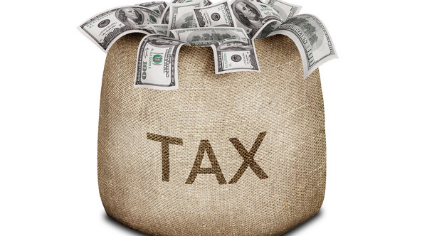
tariff, diplomacy, migrant inauguration, suffrage

Slide 33
A = tariff
Taxes.

Slide 34
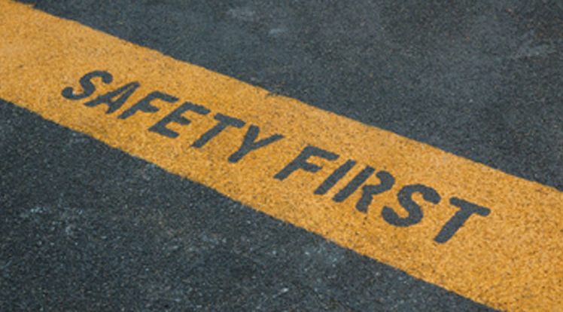
suffrage, principle, federal, migrant, persecuted

Slide 35
A = principle
A belief or value.

Slide 36
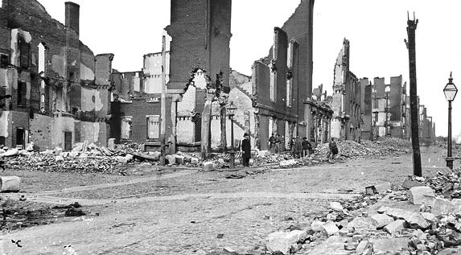
Manifest Destiny, secede, tariff, Reconstruction, federal

Slide 37
A = Reconstruction
The program to rebuild the South after the Civil War.

Slide 38
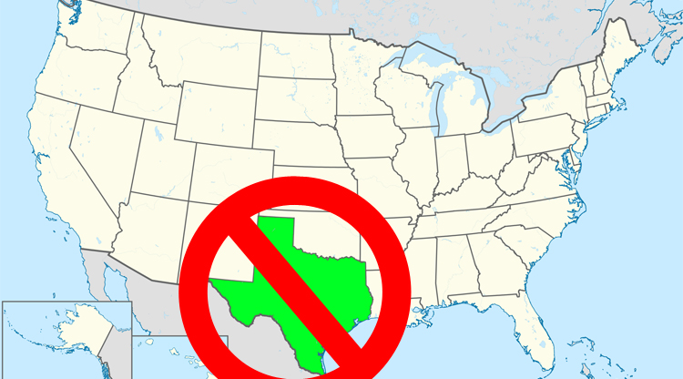
segregation, tariff, secede, migrant, principle

Slide 39
A = secede
To break away or leave the United States.

Slide 40
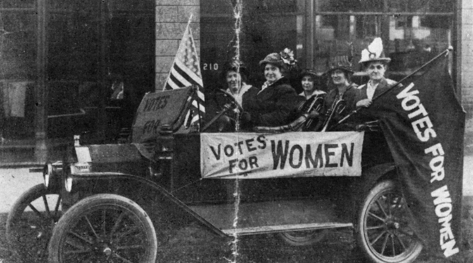
fugitive, diplomacy, abolition, suffrage, Habeas Corpus

Slide 41
A = suffrage
Voting.

Slide 42
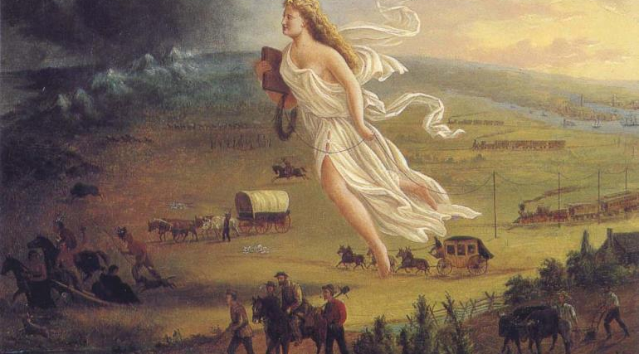
Manifest Destiny, secede, tariff, fugitive, economy

Slide 43
A = Manifest Destiny
The obvious fate that the United States would expand westward.

Slide 44
The End!

