Slide 1
Africa Unit Vocabulary
Pink Writing will be your definition for my class
White Writing is additional information that you need to know (and write)
Yellow Writing is additional information, but NOT necessary for you to write down

Slide 2
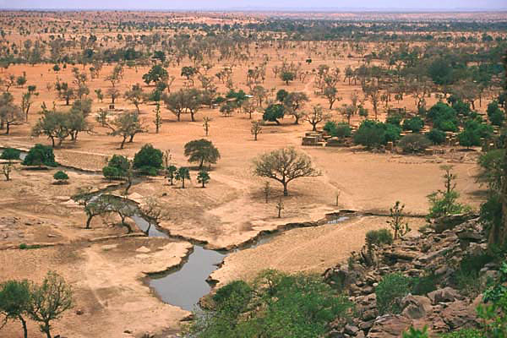
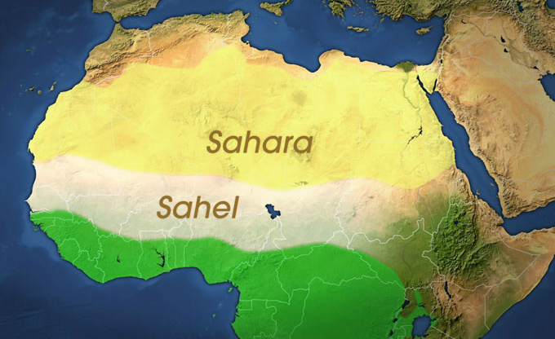
Sahel
Region of Africa along the southern edge of the Sahara with a semiarid climate
“Melting Pot” of culture between North Africa and Central Africa
Anatomy of a Sahel Drought - video

Slide 3
Desertification
Spreading of desert conditions into semiarid areas due to droughts and human over use
Farming and livestock leave land exposed and vulnerable
Is the Earth turning into a big desert? Video

Slide 4
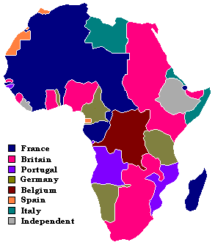
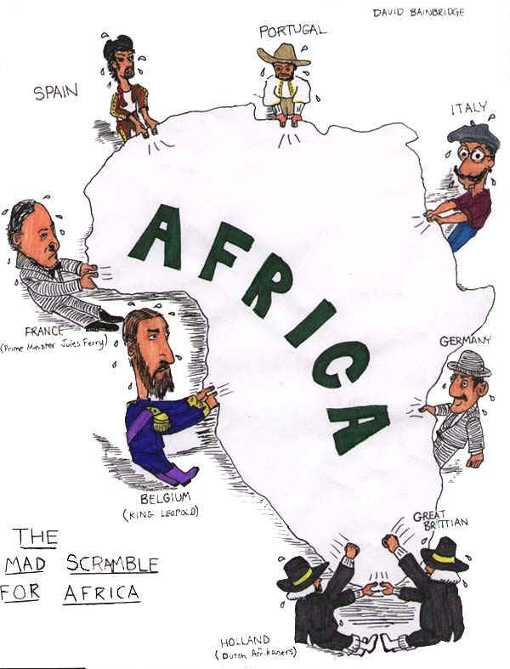
Colonial Era
Mid-to-late 1800s – most of Africa was controlled by European nations
Almost all of Africa was claimed at one time or another by a European nation
Known as the Scramble for Africa
European Colonization of Africa – Year-by-year

Slide 5
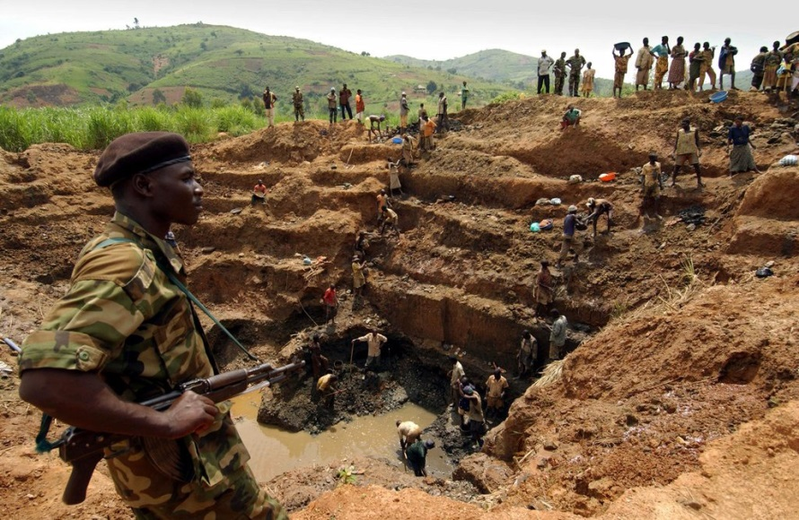
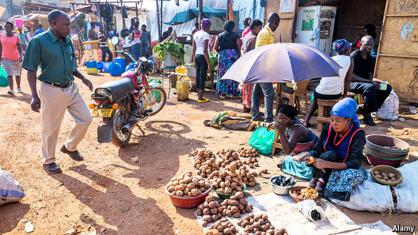
Dual Economies
One part of the economy of a country produces goods for export to wealthier countries, while the other part produces goods for their citizens to consume
Leaders of businesses or nation get rich, but leave little for their people
VS.
Conflict Diamonds
Street Vendors

Slide 6
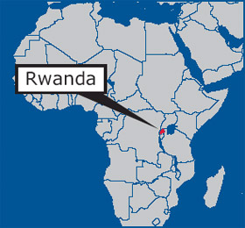
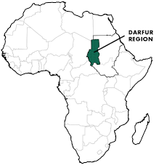
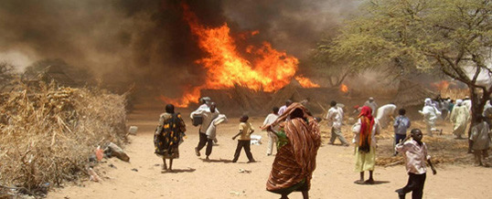
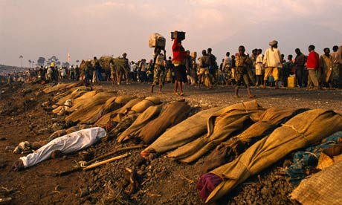
Genocide
The intentional destruction of a people
One of the worst examples of this is Rwanda
The Hutu tried to wipe out the Tutsi
800,000 Tutsis were killed in only 100 days
Another recent example is in Darfur
Emmanuel Jal – Mark Ronson Rap – War Child
Young Poet tells the story of Darfur

Slide 7
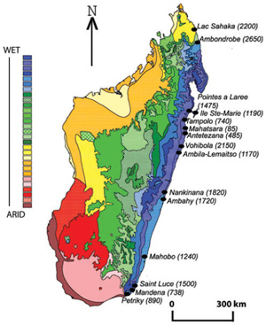
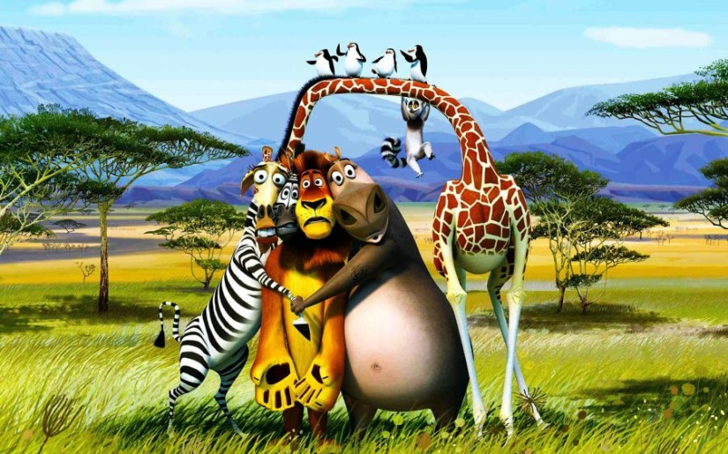
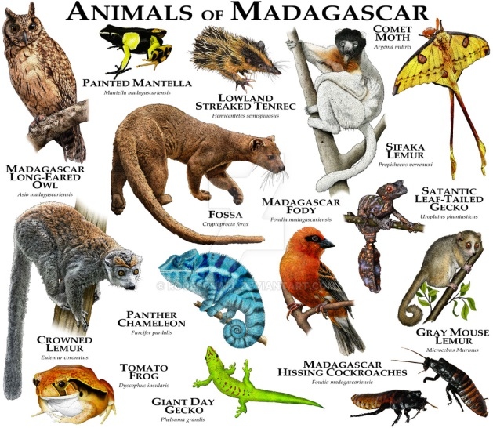
Biodiversity
Many different types of plants and animals in one area
The island of Madagascar is known for this
80 percent of its species live no where else on Earth
Wide range of climates from desert to tropical rainforest
Biodiversity of Madagascar

Slide 8
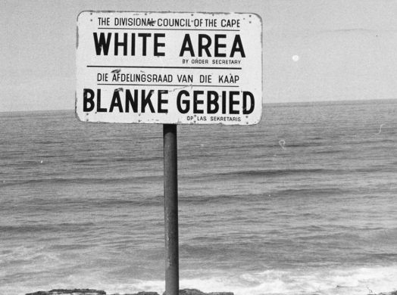
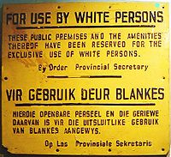
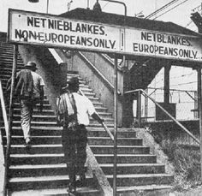
Apartheid
“separateness” – black South Africans were not allowed to live in the same areas as whites
People of mixed racial backgrounds were slightly higher up than black people
Nelson Mandela is credited for helping lead South Africa out of Apartheid

Slide 9
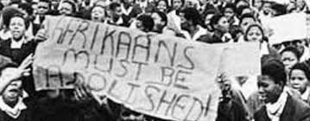
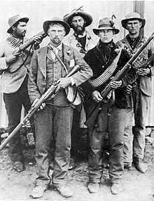
Afrikaners
Dutch farmers that settled in South Africa and considered it home
Settled near the Cape of Good Hope
They developed a new language called Afrikaans (Dutch with African words mixed in)
Responsible for creating Apartheid system in South Africa

