Slide 1
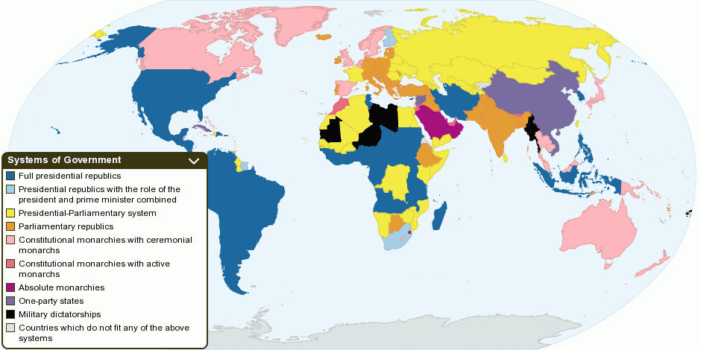
Systems of Government

Slide 2
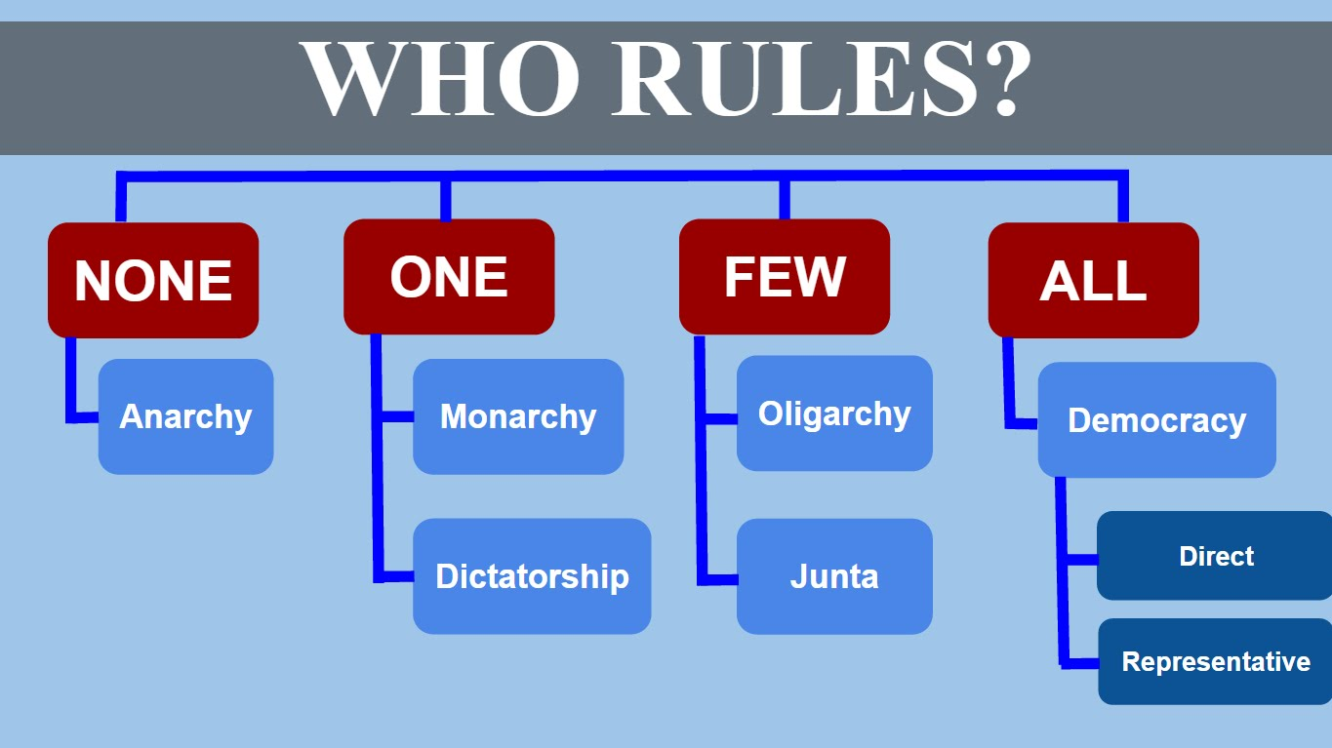
Forms of Government Video

Slide 3
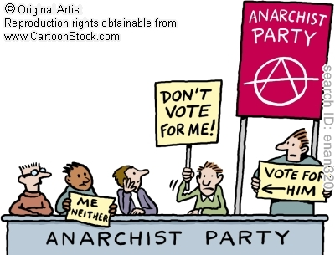
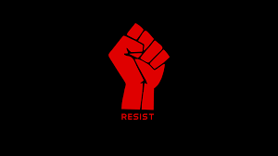
Anarchy
Type of society where there is no government to rule over the people

Slide 4
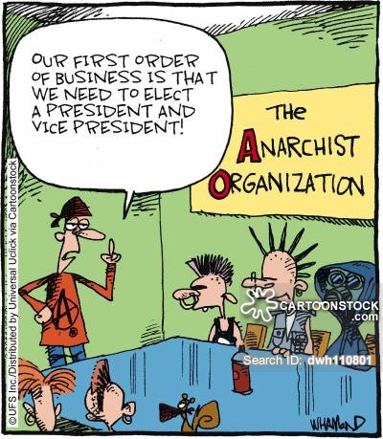
Why is this funny?

Slide 5
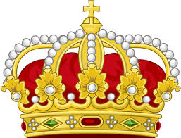
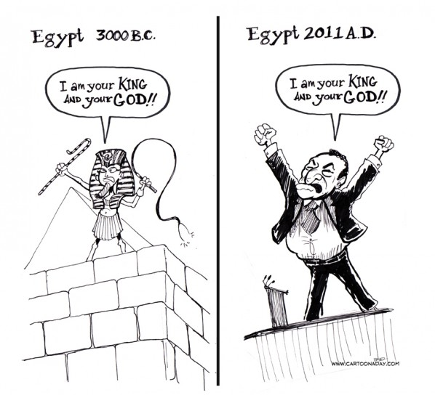
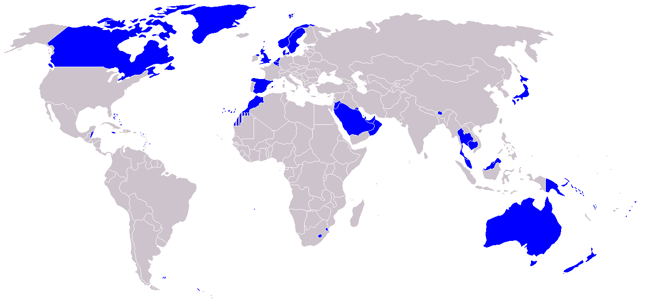
Monarchy
Type of government with a member of the royal family acting as ruler of the country.
  Known as King or Queen

Slide 6
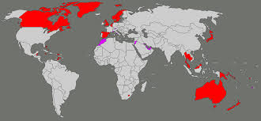
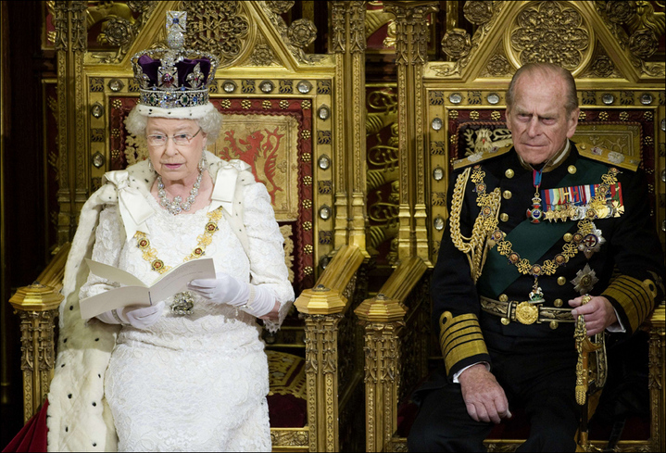
Constitutional Monarchy
The powers of the ruler are held in check by laws or constitution

Slide 7
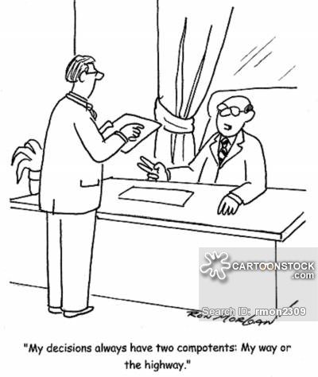
Dictatorship
Type of government that is ruled by one ruler
  Typically very authoritative

Slide 8
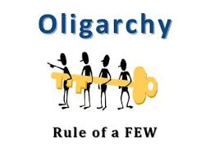
Oligarchy
Type of government where a small group of people hold the power

Slide 9
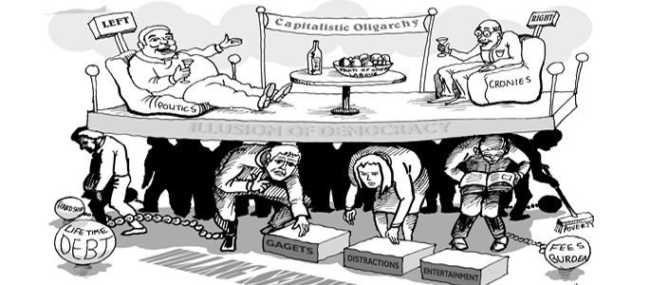
What is the artist trying to say in this political cartoon?

Slide 10
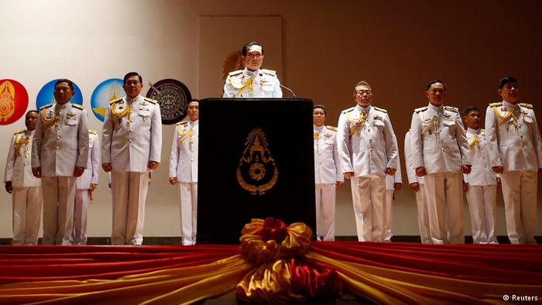
Junta
Type of government in which a small group of military leaders rule the country

Slide 11
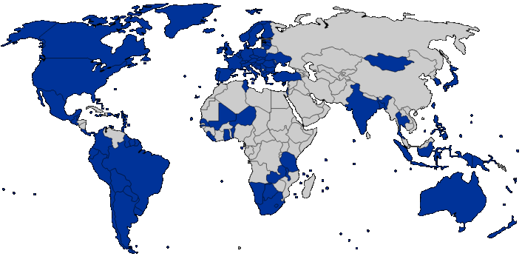
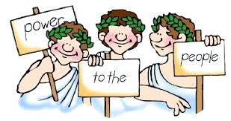
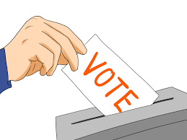
Democracy
Type of government where the leaders are elected by the people
  Direct Democracy
  Representative Democracy

Slide 12
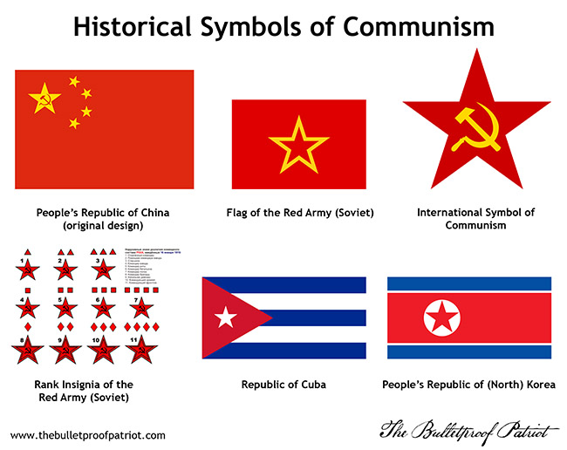
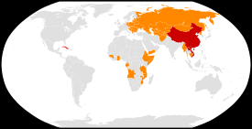
Communism
Type of government in which all property is owned by the government and divided up equally among the people

