Slide 1
Today’s Plan
Sit your normal seat.
You WILL need your notebook today.
You may talk quietly while you wait for further instructions.
Today’s plan:
Oceania Vocabulary
Brain Break: CNN 10
Oceania Vocabulary

Slide 2
Oceania Vocabulary
Pink – Definition that we will use for this class
White – Additional information that you should write
Yellow – extra information, not necessary to write, but good to know

Slide 3
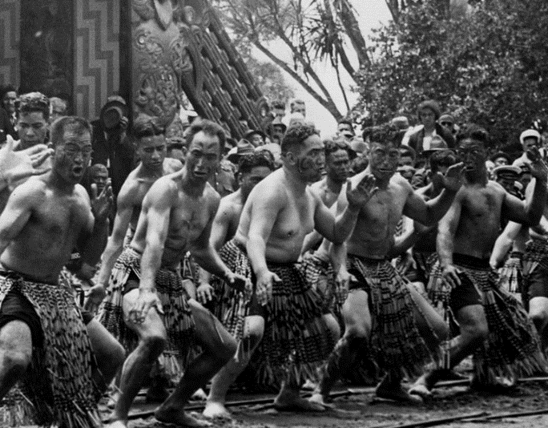
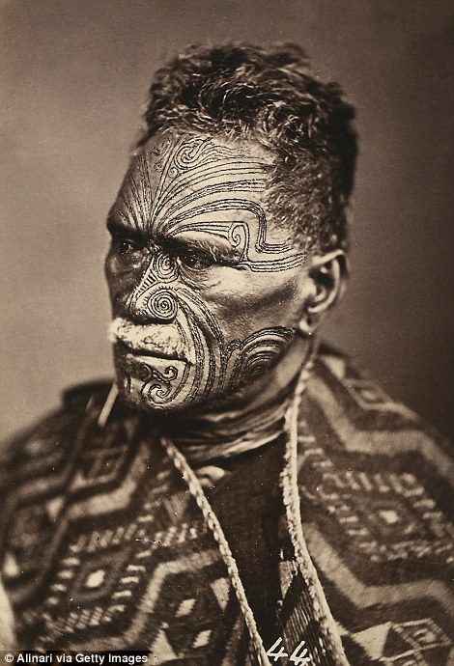
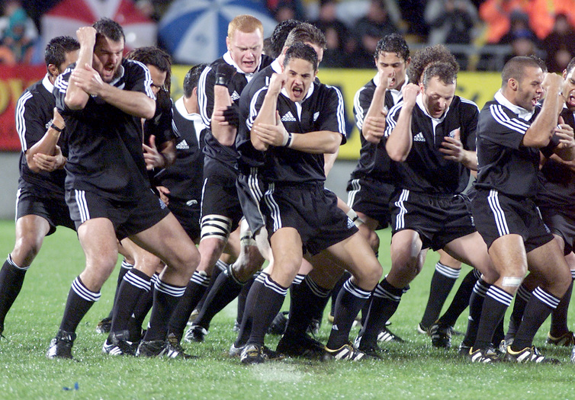
Maori
First people to live in New Zealand beginning around 1,000 years ago
Traditionally known for being fierce hunters, but now live in cities and adapted to ‘Western’ society
This transition has been difficult and many are behind in education and socio-economic status
10 Facts about Maori Video - Warning

Slide 4
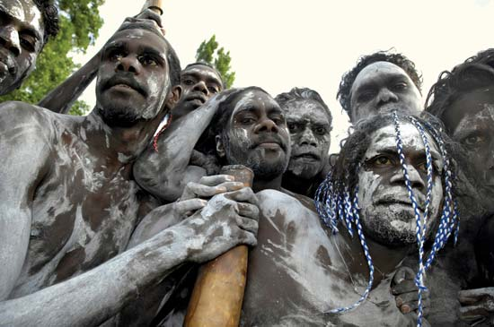
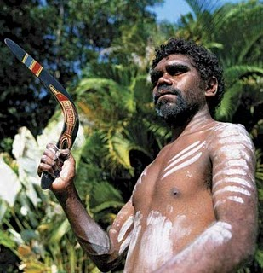
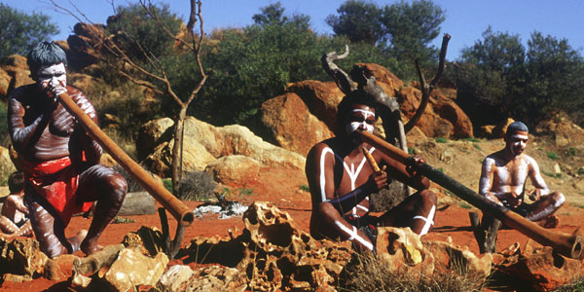
Aborigines
The first people to live in Australia beginning around 40,000 years ago
Nomadic hunters that used spears, nets and boomerangs to hunt
Most were forced off their land when Europeans came in the late 1700s
Many died from diseases
Aborigines Video

Slide 5
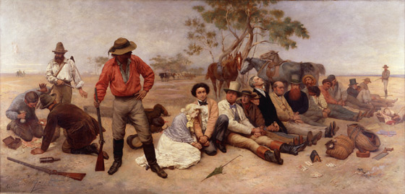
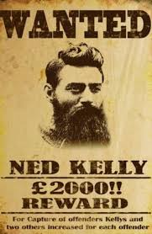
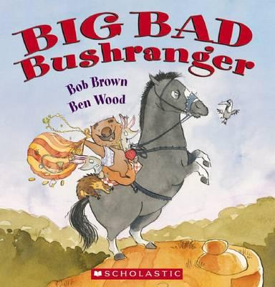
Bushrangers
An outlaw living in the bush away from people
Mostly escaped convicts
Supported their lifestyle by living off the land and stealing from others
In pop culture, they have been given a ‘Robin Hood-like’ reputation
Introduction to Bushrangers

Slide 6
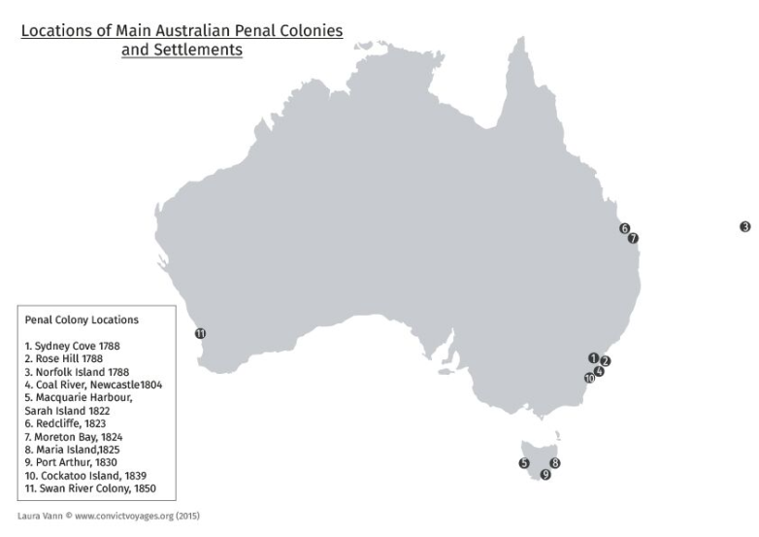
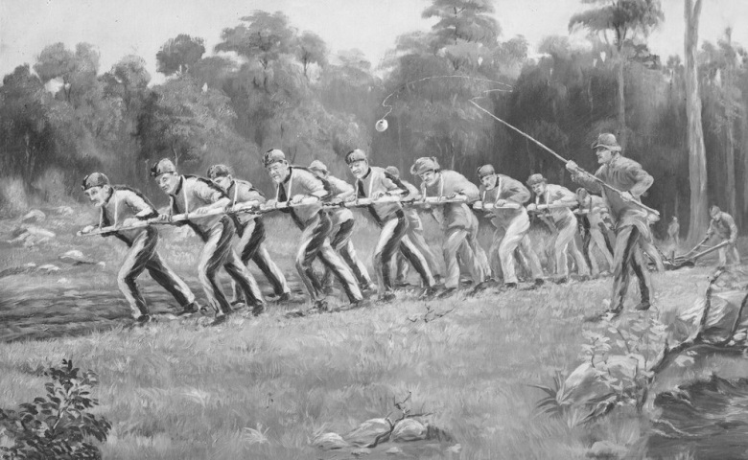
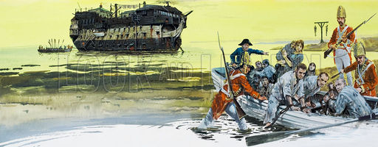
Penal Colony
Britain established Australia as a prison colony for criminals in 1788
People who committed major crimes in Britain were sent to work in Australia as slaves of free settlers
Only 6% were ‘locked up’
They were given jobs based on their work skills
Women were often forced to be wives
First Fleet Video

Slide 7
Brain Break
Brain Break: CNN 10

Slide 8
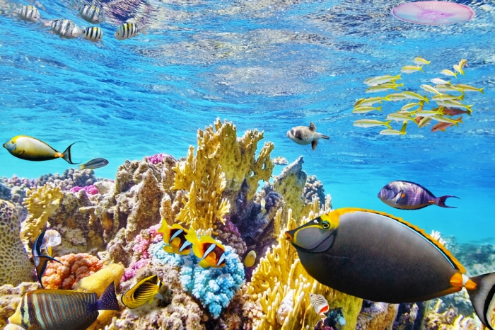
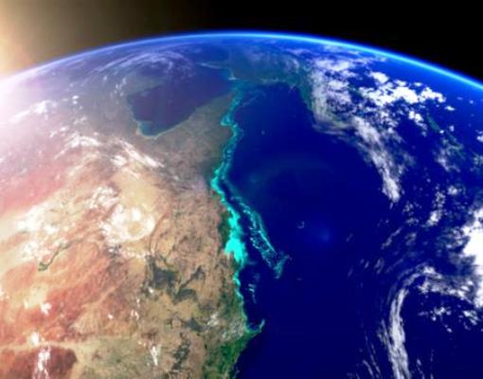
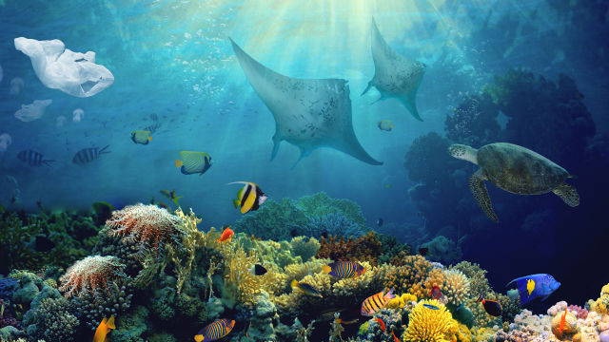
Great Barrier Reef
World’s largest living structure
Home to countless species of fish, turtles, sharks, starfish, mollusks, and 600 different hard and soft coral structures
Large enough to be seen from space
Great Barrier Reef video

Slide 9
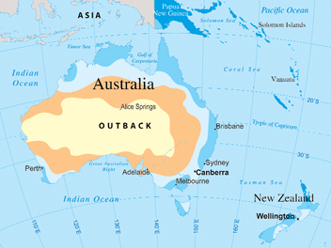
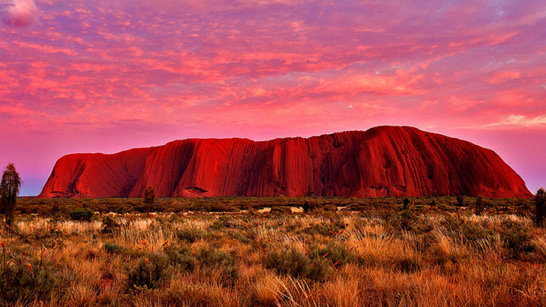
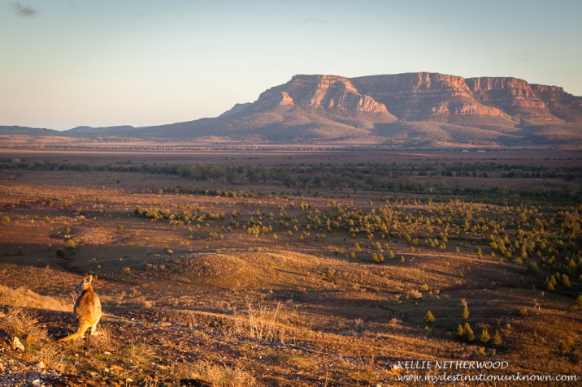
Outback
The dry, nearly uninhabited interior of Australia
No true definition, but essentially covers the VAST majority of the country
It is similar to saying “I’m from the country”
Areas considered even more remote than ‘the bush’
Outback Video

Slide 10
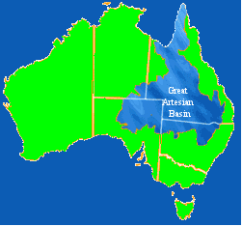
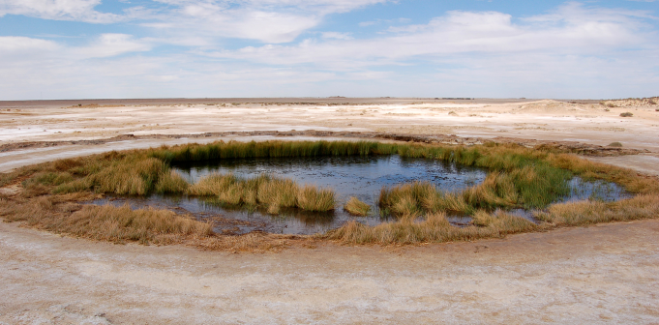
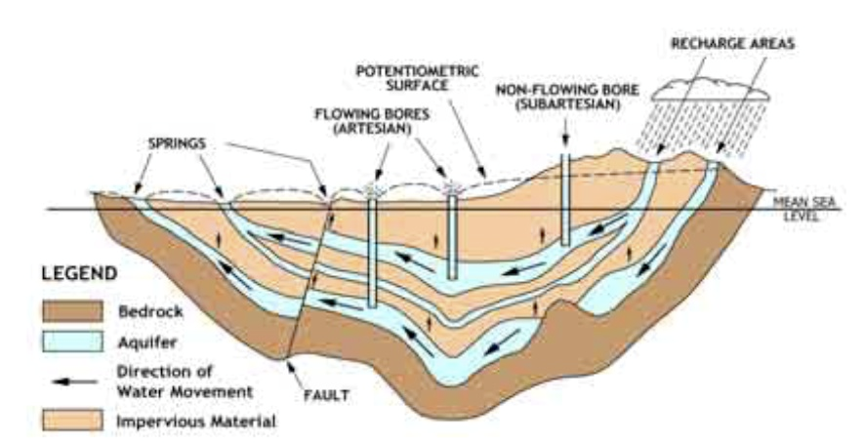
Great Artesian Basin
Large area of natural underground fresh water
Artesian wells are areas where the basin flows naturally to the surface
This water is what keeps many people alive even in the desert
Great Artesian Basin Video

Slide 11
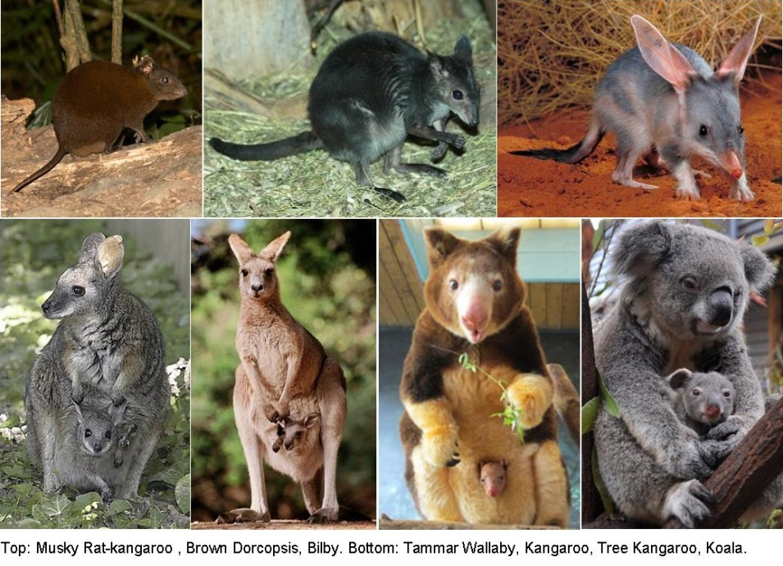
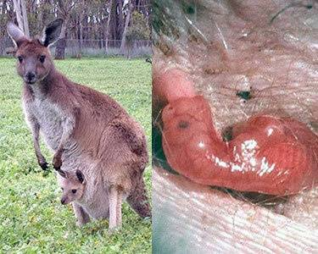
Marsupials
Mammals that have pouches to carry their young
Examples: Kangaroo, koala, wallaby
Most of Australia’s mammals are marsupials
Kangaroo Dundee clip

